Slide 1


Slide 2







Slide 3
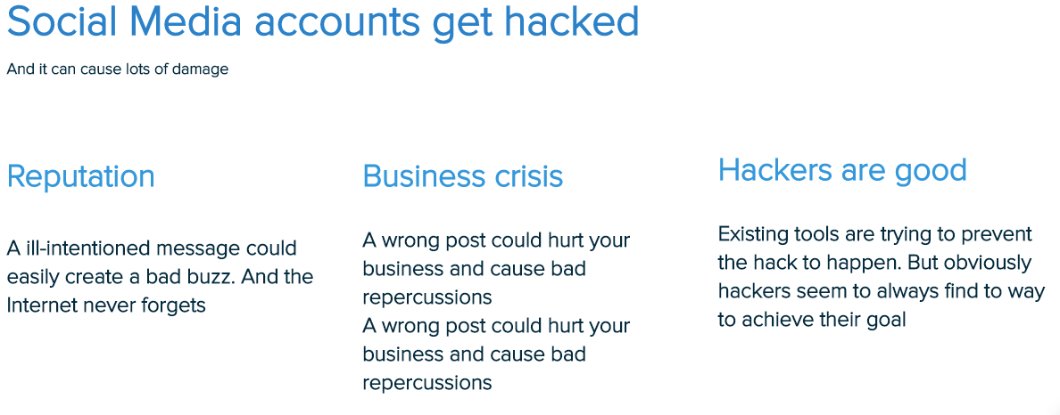

Slide 4
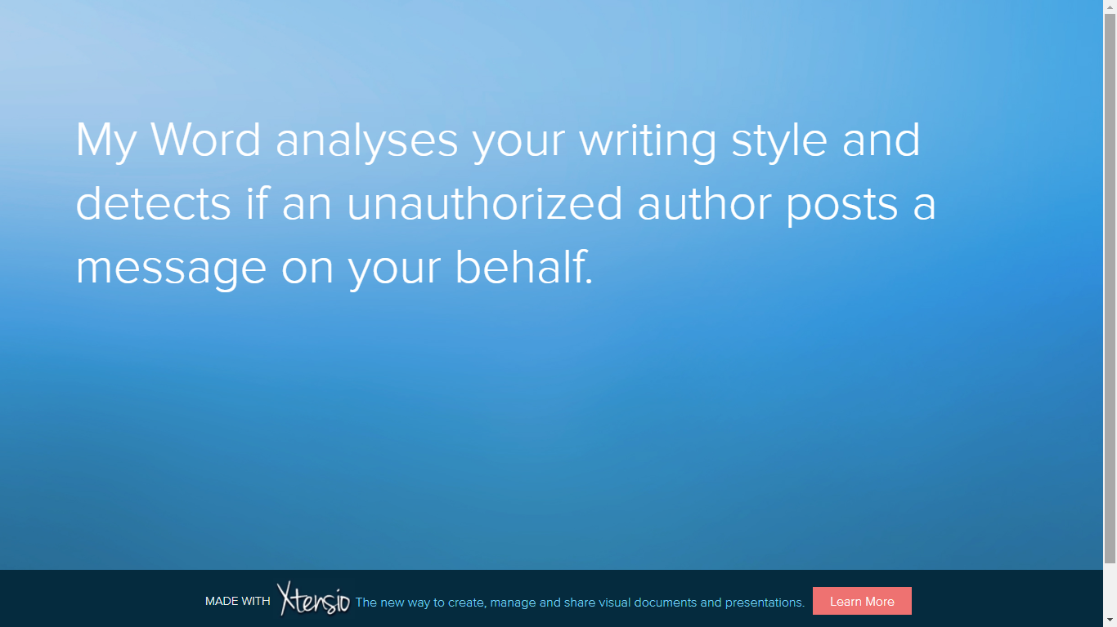

Slide 5

@VERIFIED ACCOUNT

Slide 6




Our Wizards
ALEXIS
D A V I D
Front End:
HTML
CSS: Bootstrap
Full Stack:
HTML
Python: Flask
Back End:
Python
SQLite
Machine Learning:
Scrapping
NLP

Slide 7

#Let’s do it

Slide 8

Questions so far ???
Alexis AMSELLEM – David BLOCH – David COHEN – David JACOB

Slide 9






Tech Stack

